Slide 1
Database Concurrency Control
  In concurrent execution environment if T1 conflicts with T2
  over a data item A, then the existing concurrency control
  decides if T1 or T2 should get the A and if the other
  transaction is rolled-back or waits.
Slide 18- <number>

Slide 2
Database Concurrency Control
Two-Phase Locking Techniques
  Locking is an operation which secures
    (a) permission to Read
    (b) permission to Write a data item for a transaction.
  Example:
    Lock (X). Data item X is locked in behalf of the requesting transaction.
  Unlocking is an operation which removes these permissions from the data item.
  Example:
    Unlock (X): Data item X is made available to all other transactions.
  Lock and Unlock are Atomic operations.
Slide 18- <number>

Slide 3
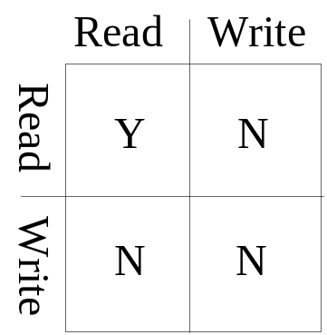
Database Concurrency Control
Two-Phase Locking Techniques: Essential components
  Two locks modes:
    (a) shared (read) (b) exclusive (write).
  Shared mode: shared lock (X)
    More than one transaction can apply share lock on X for reading its value but no write lock can be applied on X by any other transaction.
  Exclusive mode: Write lock (X)
    Only one write lock on X can exist at any time and no shared lock can be applied by any other transaction on X.
  Conflict matrix
Slide 18- <number>

Slide 4
Database Concurrency Control
Dealing with Deadlock and Starvation
  Deadlock
T’1 T’2
read_lock (Y);
read_item (Y);
read_lock (X);
read_item (Y);
write_lock (X);
(waits for X) write_lock (Y);
(waits for Y)
  Deadlock (T’1 and T’2)
Slide 18- <number>

Slide 5
Database Concurrency Control
Dealing with Deadlock and Starvation
Deadlock prevention
  A transaction locks all data items it refers to before it begins execution.
  This way of locking prevents deadlock since a transaction never waits for a data item.
  The conservative two-phase locking uses this approach.
Slide 18- <number>

